Slide 1
Computer Organization and Architecture
Lecture11 Datapath Design -- Single Cycle Control
Jihe Wang
wangjihe@nwpu.edu.cn

Slide 2
Today’s Topic
00
01. Introduction
02. How to design a microprocessor
03. Datapath for R-R operation and its timing
04. Datapath for logical operation with imm.
05. Datapath for load and store operation
06. Datapath for branch and jump operation
07. Put it together: A single cycle datapath

Slide 3
Where are we now?
1.1
The Five Classic Components of a Computer
Processor
Input
Control
Memory
Datapath
Output
Today's Topic: Design a Single Cycle Processor

Slide 4
Recap: Summary from last time
1.2
5 steps to design a processor
1. Analyze instruction set => datapath requirements
2. Select set of datapath components & establish clock methodology
3. Assemble datapath meeting the requirements
4. Analyze implementation of each instruction to determine setting of control points that effects the register transfer.
5. Assemble the control logic
MIPS makes it easier
Instructions same size
Source registers always in same place
Immediates same size, location
Operations always on registers/immediates
Single cycle datapath ⇒ CPI=1, Cycle Time = long!

Slide 5
Recap: The MIPS Instruction Formats
2.1
All MIPS instructions are 32 bits long. The three instruction formats:
R-type
I-type
J-type
The different fields are:
op: operation of the instruction
rs, rt, rd: the source and destination register specifiers
shamt: shift amount
funct: selects the variant of the operation in the “op” field
address / immediate: address offset or immediate value
target address: target address of the jump instruction
31
26
21
16
11
6
0
op
rs
rt
rd
shamt
funct
6 bits
5 bits
5 bits
5 bits
5 bits
6 bits
31
26
21
16
0
op
rs
rt
immediate
6 bits
5 bits
5 bits
16 bits
31
26
0
op
target address
6 bits
26 bits

Slide 6
An Abstract View of the Implementation
2.2
Control
Ideal
Instruction
Memory
Instruction
Control Signals
Conditions
Rd
Rs
Rt
5
5
5
Instruction
Address
A
Data
Address
Rw
Ra
Rb
32
Data
Out
32
32
Ideal
Data
Memory
32 32-bit
Registers
ALU
PC
Next Address
Data In
B
Clk
32
Clk
Clk
Datapath

Slide 7
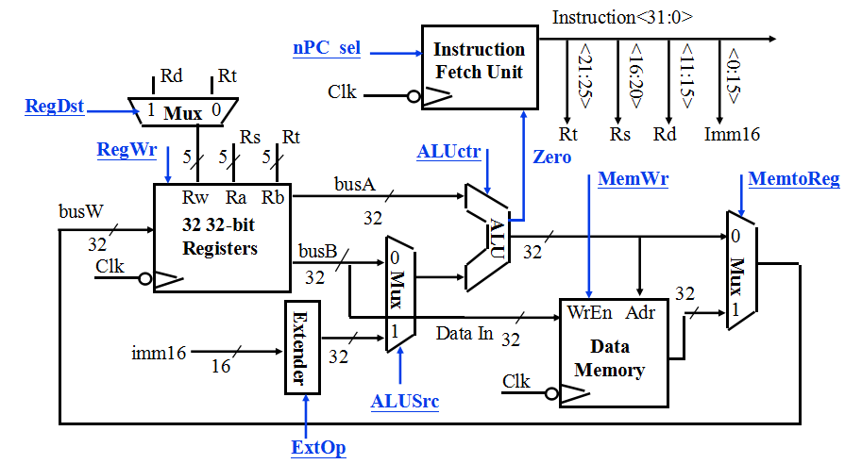
Recap: A Single Cycle Datapath
2.3
Rs, Rt, Rd and Imed16 hardwired into datapath from Fetch Unit
We have everything except control signals (underline)
Today’s lecture will show you how to generate the control signals

Slide 8
Recap: Meaning of the Control Signals
2.4
nPC_MUX_sel: 0 ⇒ PC <– PC + 4 1 ⇒ PC <– PC + 4 + SignExt(Im16) || 00
Later in lecture: higher-level connection between mux and branch cond
nPC_MUX_sel
Inst
Memory
4
Adr
Adder
00
Mux
PC
Adder
Clk
imm16
PC Ext

Slide 9
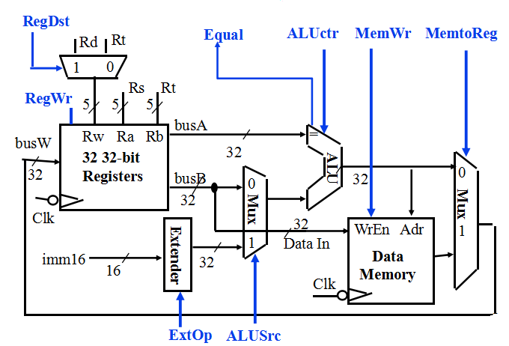
Recap: Meaning of the Control Signals
2.5
ExtOp: “zero”, “sign”
ALUsrc: 0 ⇒ regB; 1 ⇒ immed
ALUctr: “add”, “sub”, “or”
MemWr: 1 ⇒ write memory
MemtoReg: 0 ⇒ ALU; 1 ⇒ Mem
RegDst: 0 ⇒ “rt”; 1 ⇒ “rd”
RegWr: 1 ⇒ write register

Slide 10
RTL: The Add Instruction
x = 1011000
2.6
31
26
21
16
11
6
0
op
rs
rt
rd
shamt
funct
6 bits
5 bits
5 bits
5 bits
5 bits
6 bits
add rd, rs, rt
mem[PC] Fetch the instruction from memory
R[rd] <- R[rs] + R[rt] The actual operation
PC <- PC + 4 Calculate the next instruction’s address

Slide 11
Instruction Fetch Unit at the Beginning of Add
2.7
Fetch the instruction from Instruction memory: Instruction <- mem[PC]
This is the same for all instructions
Inst
Memory
Instruction<31:0>
Adr
nPC_MUX_sel
4
Adder
00
Mux
PC
Adder
Clk
imm16
PC Ext

Slide 12
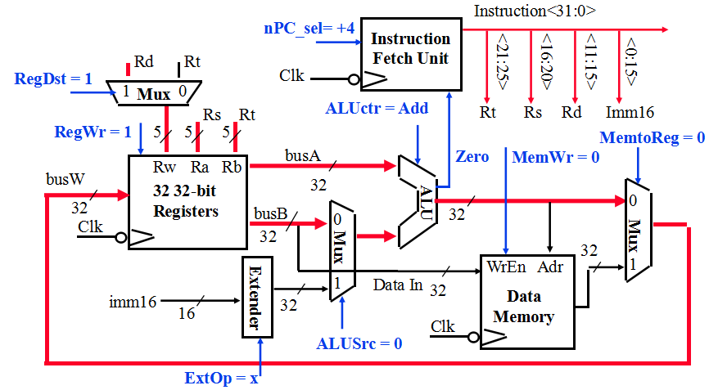
The Single Cycle Datapath during Add
2.8
31
26
21
16
11
6
0
op
rs
rt
rd
shamt
funct
R[rd] <- R[rs] + R[rt]

Slide 13
Instruction Fetch Unit at the End of Add
2.9
Instruction Fetch Unit at the End of Add
PC <- PC + 4
This is the same for all instructions except: Branch and Jump
Inst
Memory
Instruction<31:0>
Adr
nPC_MUX_sel
4
Adder
0
00
Mux
PC
1
Adder
Clk
imm16

Slide 14
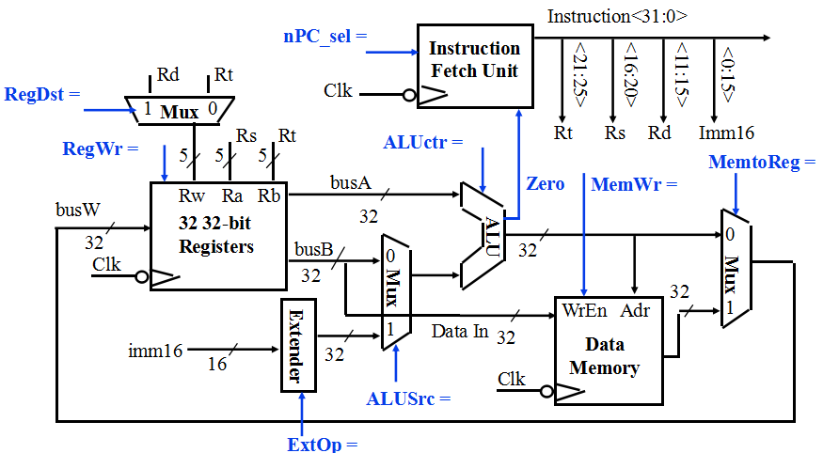
The Single Cycle Datapath during Or Immediate
2.10
31
26
21
16
0
op
rs
rt
immediate
R[rt] <- R[rs] or ZeroExt[Imm16]

Slide 15
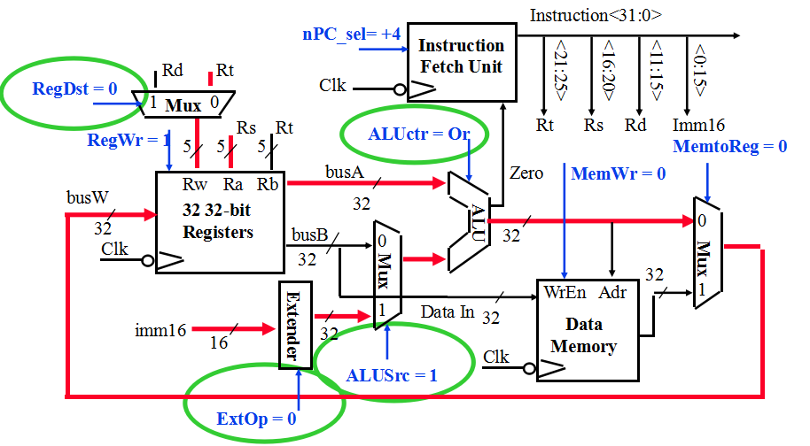
The Single Cycle Datapath during Or Immediate
3
31
26
21
16
0
op
rs
rt
immediate
R[rt] <- R[rs] or ZeroExt[Imm16]

Slide 16
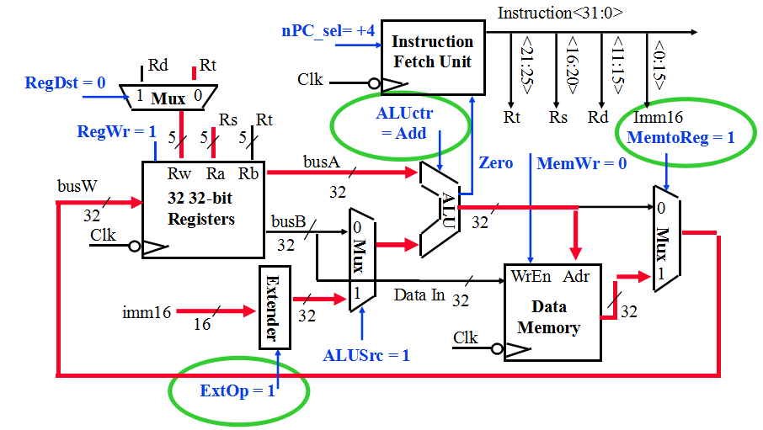
The Single Cycle Datapath during Load
3.1
31
26
21
16
0
op
rs
rt
immediate
R[rt] <- Data Memory {R[rs] + SignExt[imm16]}

Slide 17
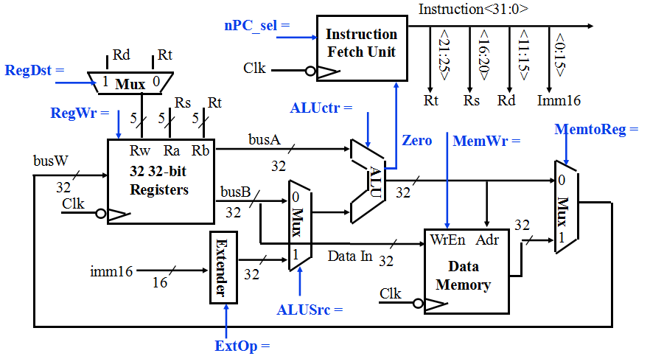
The Single Cycle Datapath during Store
3.2
31
26
21
16
0
op
rs
rt
immediate
Data Memory {R[rs] + SignExt[imm16]} <- R[rt]

Slide 18
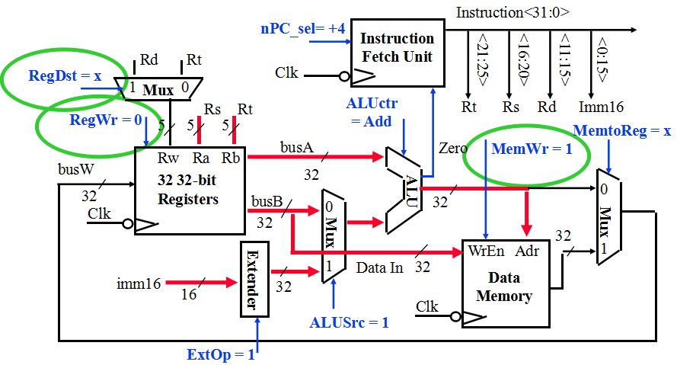
The Single Cycle Datapath during Store
3.2
31
26
21
16
0
op
rs
rt
immediate
Data Memory {R[rs] + SignExt[imm16]} <- R[rt]

Slide 19
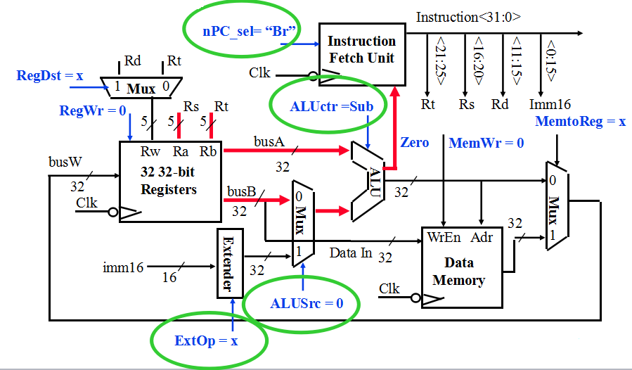
The Single Cycle Datapath during Branch
4
31
26
21
16
0
op
rs
rt
immediate
if (R[rs] - R[rt] == 0) then Zero <- 1 ; else Zero <- 0

Slide 20
Instruction Fetch Unit at the End of Branch
5.1
31
26
21
16
0
op
rs
rt
immediate
if (Zero == 1) then PC = PC + 4 + SignExt[imm16]*4 ; else PC = PC + 4
Inst
Memory
Instruction<31:0>
nPC_sel
Adr
Zero
What is encoding of nPC_sel?
Direct MUX select?
Branch / not branch
Let’s choose second option
nPC_MUX_sel
4
Adder
0
00
Mux
PC
1
Adder
Clk
imm16

Slide 21
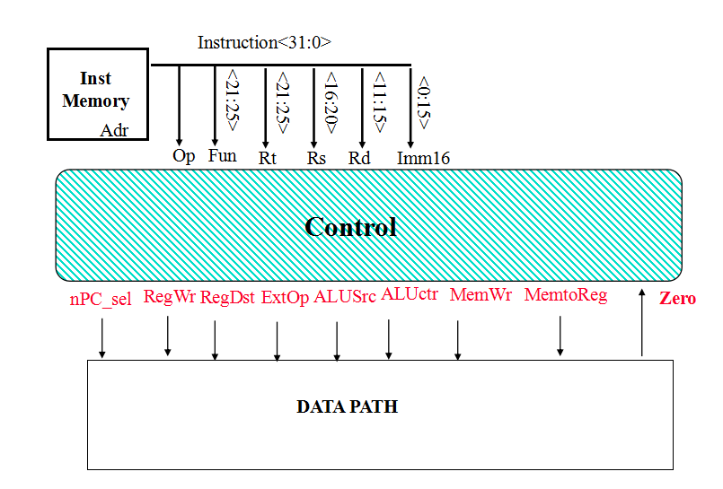
Step 4: Given Datapath: RTL -> Control
5.2

Slide 22
A Summary of Control Signals
6.1
inst Register Transfer
ADD R[rd] <– R[rs] + R[rt]; PC <– PC + 4
ALUsrc = RegB, ALUctr = “add”, RegDst = rd, RegWr, nPC_sel = “+4”
SUB R[rd] <– R[rs] – R[rt]; PC <– PC + 4
ALUsrc = RegB, ALUctr = “sub”, RegDst = rd, RegWr, nPC_sel = “+4”
ORi R[rt] <– R[rs] + zero_ext(Imm16); PC <– PC + 4
ALUsrc = Im, Extop = “Z”, ALUctr = “or”, RegDst = rt, RegWr, nPC_sel = “+4”
LOAD R[rt] <– MEM[ R[rs] + sign_ext(Imm16)]; PC <– PC + 4
ALUsrc = Im, Extop = “Sn”, ALUctr = “add”, MemtoReg, RegDst = rt, RegWr, nPC_sel = “+4”
STORE MEM[ R[rs] + sign_ext(Imm16)] <– R[rs]; PC <– PC + 4
ALUsrc = Im, Extop = “Sn”, ALUctr = “add”, MemWr, nPC_sel = “+4”
BEQ if ( R[rs] == R[rt] ) then PC <– PC + sign_ext(Imm16)] || 00 else PC <– PC + 4
nPC_sel = “Br”, ALUctr = “sub”

Slide 23
A Summary of the Control Signals
6.1
See
funct
10 0000
10 0010
We Don’t Care :-)
Appendix A
op
00 0000
00 0000
00 1101
10 0011
10 1011
00 0100
00 0010
add
sub
ori
lw
sw
beq
jump
RegDst
1
1
0
0
x
x
x
ALUSrc
0
0
1
1
1
0
x
MemtoReg
0
0
0
1
x
x
x
RegWrite
1
1
1
1
0
0
0
MemWrite
0
0
0
0
1
0
0
nPCsel
0
0
0
0
0
1
0
Jump
0
0
0
0
0
0
1
ExtOp
x
x
0
1
1
x
x
ALUctr<2:0>
Add
Subtract
Or
Add
Add
Subtract
xxx
31
26
21
16
11
6
0
R-type
op
rs
rt
rd
shamt
funct
add, sub
I-type
op
rs
rt
immediate
ori, lw, sw, beq
J-type
op
target address
jump

Slide 24
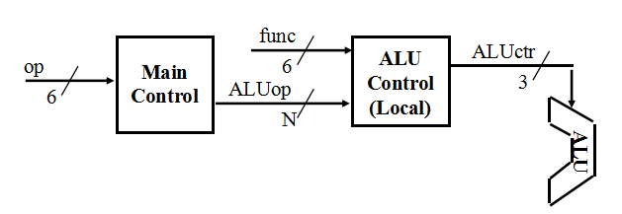
The Concept of Local Decoding
6.2
op
00 0000
00 1101
10 0011
10 1011
00 0100
00 0010
R-type
ori
lw
sw
beq
jump
RegDst
1
0
0
x
x
x
ALUSrc
0
1
1
1
0
x
MemtoReg
0
0
1
x
x
x
RegWrite
1
1
1
0
0
0
MemWrite
0
0
0
1
0
0
Branch
0
0
0
0
1
0
Jump
0
0
0
0
0
1
ExtOp
x
0
1
1
x
x
ALUop<N:0>
“R-type”
Or
Add
Add
Subtract
xxx

Slide 25
The Encoding of ALUop
6.3
func
op
Main
Control
6
ALU
Control
(Local)
ALUctr
6
ALUop
3
N
In this exercise, ALUop has to be 2 bits wide to represent:
(1) “R-type” instructions
“I-type” instructions that require the ALU to perform:
(2) Or, (3) Add, and (4) Subtract
To implement the full MIPS ISA, ALUop has to be 3 bits to represent:
(1) “R-type” instructions
“I-type” instructions that require the ALU to perform:
(2) Or, (3) Add, (4) Subtract, and (5) And (Example: andi)
R-type
ori
lw
sw
beq
jump
ALUop (Symbolic)
“R-type”
Or
Add
Add
Subtract
xxx
ALUop<2:0>
1 00
0 10
0 00
0 00
0 01
xxx

Slide 26
The Decoding of the “func” Field
6.3
func
op
Main
Control
6
ALU
Control
(Local)
ALUctr
6
ALUop
3
N
R-type
ori
lw
sw
beq
jump
ALUop (Symbolic)
“R-type”
Or
Add
Add
Subtract
xxx
ALUop<2:0>
1 00
0 10
0 00
0 00
0 01
xxx
31
26
21
16
11
6
0
R-type
op
rs
rt
rd
shamt
funct
P. 286 text:
funct<5:0>
Instruction Operation
ALUctr
ALUctr<2:0>
ALU Operation
10 0000
add
000
And
10 0010
subtract
001
Or
10 0100
and
ALU
010
Add
10 0101
or
110
Subtract
10 1010
set-on-less-than
111
Set-on-less-than

Slide 27
The Truth Table for ALUctr
6.4
funct<3:0>
Instruction Op.
0000
add
ALUop
(Symbolic)
R-type
ori
lw
sw
beq
0010
subtract
“R-type”
Or
Add
Add
Subtract
0100
and
ALUop<2:0>
1 00
0 10
0 00
0 00
0 01
0101
or
1010
set-on-equal
ALUop
func
ALU
Operation
ALUctr
bit<2>
bit<1>
bit<0>
bit<3>
bit<2>
bit<1>
bit<0>
bit<2>
bit<1>
bit<0>
0
0
0
x
x
x
x
Add
0
1
0
0
x
1
x
x
x
x
Subtract
1
1
0
0
1
x
x
x
x
x
Or
0
0
1
1
x
x
0
0
0
0
Add
0
1
0
1
x
x
0
0
1
0
Subtract
1
1
0
1
x
x
0
1
0
0
And
0
0
0
1
x
x
0
1
0
1
Or
0
0
1
1
x
x
1
0
1
0
Set on ==
1
1
1

Slide 28
The Logic Equation for ALUctr<2>
6.5
ALUop
func
bit<2>
bit<1>
bit<0>
bit<3>
bit<2>
bit<1>
bit<0>
ALUctr<2>
0
x
1
x
x
x
x
1
1
x
x
0
0
1
0
1
1
x
x
1
0
1
0
1
This makes func<3> a don’t care
ALUctr<2> = !ALUop<2> & ALUop<0> +
ALUop<2> & !func<2> & func<1> & !func<0>

Slide 29
The Logic Equation for ALUctr<1>
6.5
ALUop
func
bit<2>
bit<1>
bit<0>
bit<3>
bit<2>
bit<1>
bit<0>
ALUctr<1>
0
0
0
x
x
x
x
1
0
x
1
x
x
x
x
1
1
x
x
0
0
0
0
1
1
x
x
0
0
1
0
1
1
x
x
1
0
1
0
1
ALUctr<1> = !ALUop<2> & !ALUop<1> +
ALUop<2> & !func<2> & !func<0>

Slide 30
The Logic Equation for ALUctr<0>
7
ALUop
func
bit<2>
bit<1>
bit<0>
bit<3>
bit<2>
bit<1>
bit<0>
ALUctr<0>
0
1
x
x
x
x
x
1
1
x
x
0
1
0
1
1
1
x
x
1
0
1
0
1
ALUctr<0> = !ALUop<2> & ALUop<1>
+ ALUop<2> & !func<3> & func<2> & !func<1> & func<0>
+ ALUop<2> & func<3> & !func<2> & func<1> & !func<0>

Slide 31
The ALU Control Block
7.1
func
6
ALU
Control
(Local)
ALUctr
ALUop
3
3
ALUctr<2> = !ALUop<2> & ALUop<0> +
ALUop<2> & !func<2> & func<1> & !func<0>
ALUctr<1> = !ALUop<2> & !ALUop<1> +
ALUop<2> & !func<2> & !func<0>
ALUctr<0> = !ALUop<2> & ALUop<1>
+ ALUop<2> & !func<3> & func<2> & !func<1> & func<0>
+ ALUop<2> & func<3> & !func<2> & func<1> & !func<0>

Slide 32
Step 5: Logic for each control signal
7.2
nPC_sel <= if (OP == BEQ) then “Br” else “+4”
ALUsrc <= if (OP == “Rtype”) then “regB” else “immed”
ALUctr <= if (OP == “Rtype”) then func t elseif (OP == ORi) then “OR” elseif (OP == BEQ) then “sub” else “add”
ExtOp <= _____________
MemWr <= _____________
MemtoReg <= _____________
RegWr: <=_____________
RegDst: <= _____________

Slide 33
Step 5: Logic for each control signal
nPC_sel <= if (OP == BEQ) then “Br” else “+4”
ALUsrc <= if (OP == “Rtype”) then “regB” else “immed”
ALUctr <= if (OP == “Rtype”) then funct elseif (OP == ORi) then “OR” elseif (OP == BEQ) then “sub” else “add”
ExtOp <= if (OP == ORi) then “zero” else “sign”
MemWr <= (OP == Store)
MemtoReg <= (OP == Load)
RegWr: <= if ((OP == Store) || (OP == BEQ)) then 0 else 1
RegDst: <= if ((OP == Load) || (OP == ORi)) then 0 else 1

Slide 34
The “Truth Table” for the Main Control
RegDst
func
ALUSrc
ALU
Control
(Local)
ALUctr
op
Main
Control
:
6
3
6
ALUop
3
op
00 0000
00 1101
10 0011
10 1011
00 0100
00 0010
R-type
ori
lw
sw
beq
jump
RegDst
1
0
0
x
x
x
ALUSrc
0
1
1
1
0
x
MemtoReg
0
0
1
x
x
x
RegWrite
1
1
1
0
0
0
MemWrite
0
0
0
1
0
0
nPC_sel
0
0
0
0
1
0
Jump
0
0
0
0
0
1
ExtOp
x
0
1
1
x
x
ALUop (Symbolic)
“R-type”
Or
Add
Add
Subtract
xxx
ALUop <2>
1
0
0
0
0
x
ALUop <1>
0
1
0
0
0
x
ALUop <0>
0
0
0
0
1
x

Slide 35
The “Truth Table” for RegWrite
op
00 0000
00 1101
10 0011
10 1011
00 0100
00 0010
R-type
ori
lw
sw
beq
jump
RegWrite
1
1
1
0
0
0
RegWrite = R-type + ori + lw
= !op<5> & !op<4> & !op<3> & !op<2> & !op<1> & !op<0> (R-type)
+ !op<5> & !op<4> & op<3> & op<2> & !op<1> & op<0> (ori)
+ op<5> & !op<4> & !op<3> & !op<2> & op<1> & op<0> (lw)
.
.
.
.
.
.
op<5>
.
op<5>
.
op<5>
.
op<5>
.
op<5>
.
op<5>
.
<0>
<0>
<0>
<0>
<0>
op<0>
R-type
ori
lw
sw
beq
jump
RegWrite

Slide 36
PLA Implementation of the Main Control
.
.
.
.
.
.
op<5>
.
op<5>
.
op<5>
.
op<5>
.
op<5>
.
op<5>
.
<0>
<0>
<0>
<0>
<0>
op<0>
R-type
ori
lw
sw
beq
jump
RegWrite
ALUSrc
RegDst
MemtoReg
MemWrite
Branch
Jump
ExtOp
ALUop<2>
ALUop<1>
ALUop<0>

Slide 37
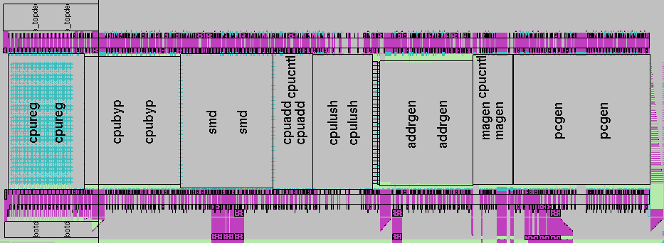
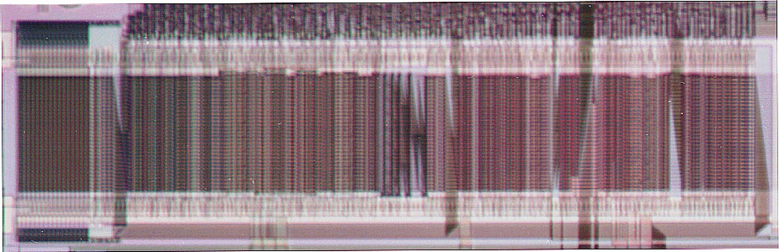
A Real MIPS Datapath (CNS T0)

Slide 38
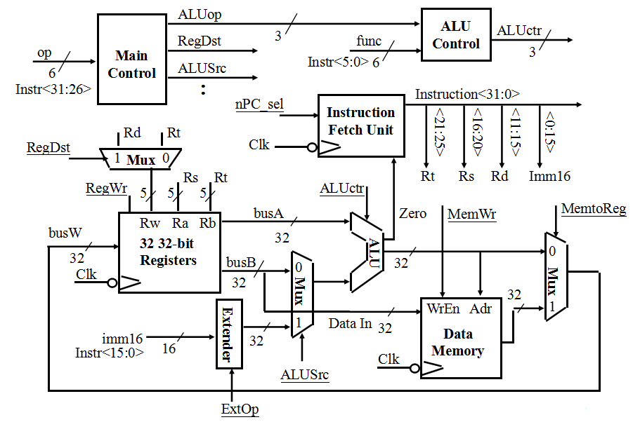
Putting it All Together: A Single Cycle Processor

Slide 39
Recap: An Abstract View of the Critical Path (Load)
Register file and ideal memory:
The CLK input is a factor ONLY during write operation
During read operation, behave as combinational logic:
Address valid => Output valid after “access time.”
Critical Path (Load Operation) =
PC’s Clk-to-Q +
Instruction Memory’s Access Time +
Register File’s Access Time +
ALU to Perform a 32-bit Add +
Data Memory Access Time +
Setup Time for Register File Write +
Clock Skew
Ideal
Instruction
Memory
Instruction
Rd
Rs
Rt
Imm
5
5
5
16
Instruction
Address
A
Data
Address
Rw
Ra
Rb
32
32
32
Ideal
Data
Memory
32 32-bit
Registers
ALU
PC
Next Address
Data In
B
Clk
Clk
Clk
32

Slide 40
Worst Case Timing (Load)
Clk
Clk-to-Q
PC
Old Value
New Value
Instruction Memory Access Time
Rs, Rt, Rd,
Op, Func
Old Value
New Value
Delay through Control Logic
ALUctr
Old Value
New Value
ExtOp
Old Value
New Value
ALUSrc
Old Value
New Value
MemtoReg
Old Value
New Value
Register
Write Occurs
RegWr
Old Value
New Value
Register File Access Time
busA
Old Value
New Value
Delay through Extender & Mux
busB
Old Value
New Value
ALU Delay
Address
Old Value
New Value
Data Memory Access Time
busW
Old Value
New

Slide 41
Drawback of this Single Cycle Processor
Long cycle time:
Cycle time must be long enough for the load instruction:
PC’s Clock -to-Q +
Instruction Memory Access Time +
Register File Access Time +
ALU Delay (address calculation) +
Data Memory Access Time +
Register File Setup Time +
Clock Skew
Cycle time for load is much longer than needed for all other instructions

Slide 42
Preview
Next Time: MultiCycle Data Path
CPI ≥ 1, CycleTime much shorter (~1/5 of time)

Slide 43
Summary
Single cycle datapath => CPI=1, CCT => long
5 steps to design a processor
1. Analyze instruction set => datapath requirements
2. Select set of datapath components & establish clock methodology
3. Assemble datapath meeting the requirements
4. Analyze implementation of each instruction to determine setting of control points that effects the register transfer.
5. Assemble the control logic
Control is the hard part
MIPS makes control easier
Instructions same size
Source registers always in same place
Immediates same size, location
Operations always on registers/immediates
Processor
Input
Control
Memory
Datapath
Output

